Slide 1
Examining genetic background effects on canalization in d. melanogaster
Brandon mcintyre & rajat Bhargava

Slide 2
Presentation outline
Background information
Defining canalization
Levene’s stat
Info about data set
Biological questions
Between line and within line variation
are Log transformations appropriate here?
MODELING + CORRELATION PLOTS
-RANK-REDUCED MODEL
-Markov chain monte carlo generalized linear mixed model (mcmcglmm)
Next steps
Notes:
Before we move into the statistical analysis and modeling we conducted to answering how genetic background effects affect variability I

Slide 3
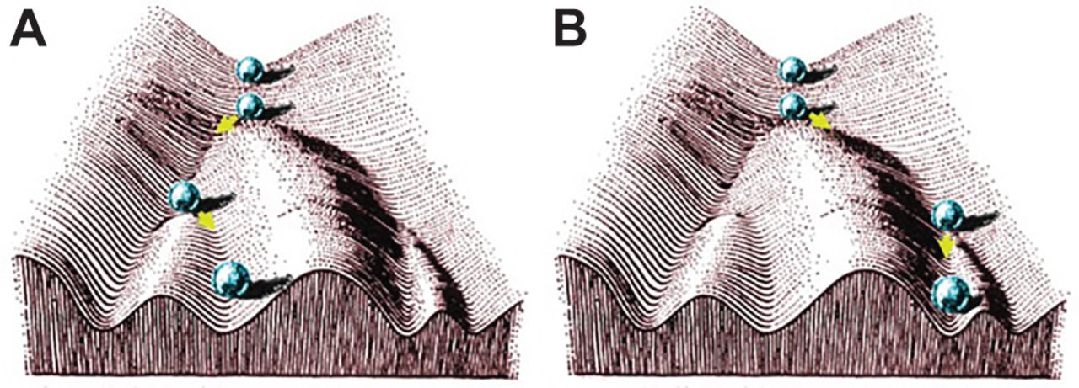
Canalization
Waddington's developmental landscape diagram (modified diagram by K. Mitchell) (1957)
Notes:
Waddington's developmental landscape diagram. The landscape itself and the ball at the top are from his original diagram. The subsequent positions of the ball have been added to illustrate his point that development can be canalized to follow different routes (A and B). The plasticity to enable this to happen already exists in the wild population of organisms (modified diagram by K. Mitchell).
Genetic background dependence is a common trait of all eukaryotic gene systems that modulates the phenotypic effects of a mutant allele due to segregating genetic variation among different wild type strains.
Pictured here is a diagram from the work done by Waddington on the ability of a population of Drosophila being canalized via environmental or chemical changes to change their phenotype when starting from the same genotype. Where the population in question is represented by the blue sphere.
This is represented by changing the slope of one part of the diagram via perturbation (be it genetic or environmental) as seen in the yellow box in Panel A. In order to canalize a fate of a population into showing a distinct phenotype as seen by the change in the sphere’s trajectory in panel B. If perturbing over enough generations and selecting that phenotypic trait such that when that perturbation is no longer present the characteristic remains in the population’s genetics, the trait is canalized.
This canalization took advantage of plasticity that is seen in a population, suggesting that the alleles necessary to enable this characteristic inheritance were available within the population but were not displayed until perturbation.
This implies that canalization depends on the ability of a trait to vary where canalized traits show reduced variability or to capacity to vary and decanalization leads to increases in variability or ability to vary.
A canalized phenotypic is characterized by low variation despite environmental or genetic perturbations.

Slide 4
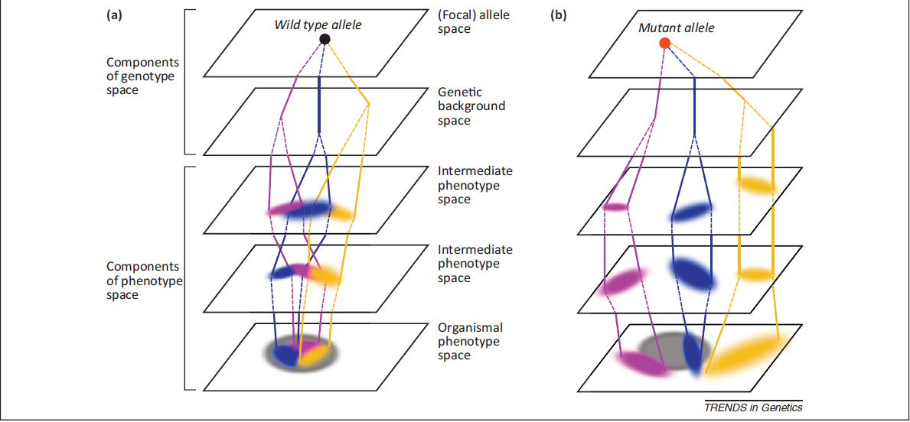
Genotype phenotype map
(Chandler et al. 2013)
Notes:
Canalization might be more easily visualized utilizing a genotype phenotype map. In this map:
Grey area in the phenotype space represents the range wild type phenotypic expression
Each coloured line represents a distinct genotype or strain Ex. Blue line
Upon mutation, variation among genetic backgrounds is revealed through distinct mutant phenotypes that may also overlap with the range wild type phenotypic appearance and Cryptic genetic variation (or hidden variation displayed during perturbation) is revealed by broader distribution of these traits.
For example the change from the “yellow” strain in a to the same “yellow” strain in b
With regards to canalization if a trait is canalized then we would observe perturbations or mutations to have a reduced effect on changes in phenotypic variability leading to a retainment of wild type appearance.
As you can see on this map nothing occurs in a vacuum and many levels exist to this map where interactions at every level can affect the phenotype of specific genotypes, as represented by the genetic background and intermediate spaces which can lead to drastically different phenotypes depending on the many interactions and processes from beginning to end of the central dogma (including protein-protein interactions, folding, mRNA levels, ect.) Both genotype and environment affect trait expression whereby mutational effects on trait expression can be context dependent, interacting with environmental effects in which the mutation occurs leading to changes in variability in phenotypic traits.
Among this is genetic background effects or alleles at other genes throughout the genome that interact with the focal gene or allele of interest.

Slide 5

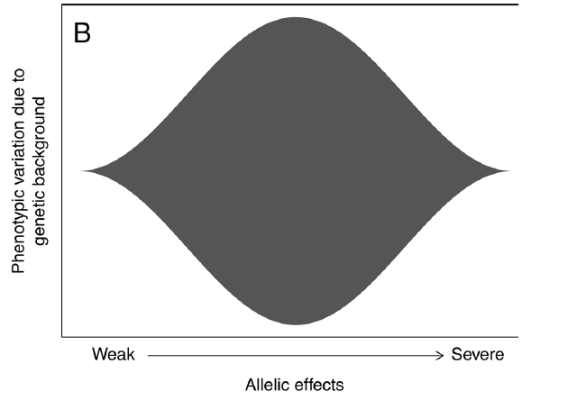
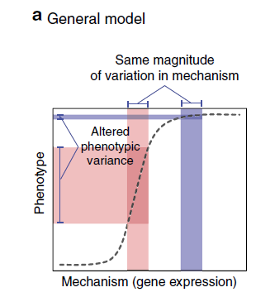
“goldilocks” phenomenon
Severe and weak phenotypic effect alleles are least sensitive to genetic background effects
Alleles that produce moderate phenotypic effects are most sensitive to genetic background effects
(Chandler et al. 2017)
(Green et al. 2017)
Notes:
Though we can observe variation between and among backgrounds or strains what is not clear how exactly this variation manifests itself. Is there a way to predict variability based on the manifestation of a phenotype or its related genotype? Recent work by Chandler et al. have observed a goldilocks phenomenon where: Alleles that produce severe or weak phenotypic effects are least sensitive to genetic background effects
Alleles that produce moderate phenotypic effects are most sensitive to genetic background effects
This relationship is believed to be characterized by the non-linear sigmoidal relationship between gene activity and phenotypic effect. Whereby, a threshold of gene activity for a normal (Wild Type) trait must be met to ensure phenotypic expression. In canalized traits, this threshold is mediated by compensatory mechanisms in the genetic background in response to perturbations minimizing phenotypic variance from the wild type.
In this image wild type is expressed in blue while mutants expressed in red whereby the amount of a developmental process (gene activity) determines the phenotype
- The same magnitude of variation in the mechanisms results in drastically different variation in phenotypic expression

Slide 6
Defining canalization
No agreement on what defines canalization
Two main definitions
Reaction norm of the mean
Variation approach
Notes:
If we are studying canalization it would be expected that this object of study would be clearly defined.
However over the years there have been many studies of canalization but no agreement on what defines it.
Broadly there are two main definitions of canalization
The reaction norm of the mean
Variation approach
But may ask why should we care which definition of canalization we are using?
- The reason is because depending on the definition used a different metric may be used to measure canalization

Slide 7
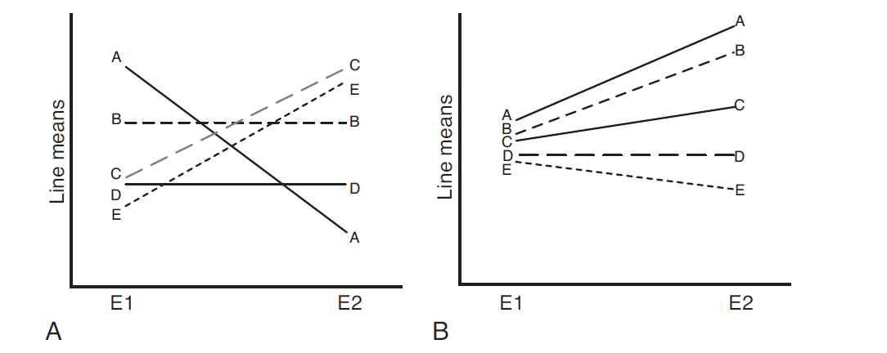
Reaction norm of the mean
(Dworkin, 2005)
Notes:
Pictured here is an image of a reaction norm graphs:
whereby A,B,C,D, and E each represent genetically distinct lines of animals where the individuals within these lines are genetically identical(or close to)
On the x-axis: E1 and E2 represent: environment 1 and environment 2 where we have experimentally introduced a perturbation (be that be genetic or environmental)
On the y-axis: are the line means, which is the measure of a certain trait, say for D. melanogaster wing size.
In panel A:
You can see each line has a distinct line mean
When you change the environment or treatment you can observe changes in line means in A,E, and C but not D and B
According to the reaction norm of the mean definition of canalization is the opposite of phenotypic plasticity
Therefore lines D and B are canalized to environment E1 and E2
Or there is no environmental effect on trait expression which was possibly mediated by genetic background effects
In this approach canalization is inferred by the decanalization of a system through environmental (genetic or otherwise) stress that causes a perturbation of normal trait expression
If see a change in phenotypic variation can ask if we infer the release of genetic variation for the trait
An idealized example of this is seen in panel B
Where each line has relatively little between line variation (mean wing size is close together)
When these same lines are exposed to E2 i.e. the stressful environment there is a significant increase in the between line variation (due to the GBE of released cryptic(hidden) genetic variation of trait expression)
Fundamentally the more canalized a line is the less it’s mean should change across environments

Slide 8
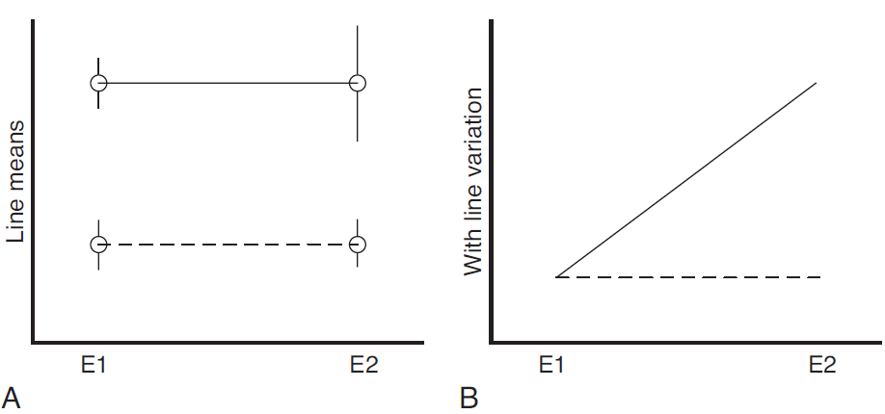
Variation approach
(Dworkin, 2005)
Notes:
Second definition of canalization is fundamentally concerned with not how the line mean changes but how the measure of variation within lines changes.
Pictured in panel A
Is another reaction norm graph but a measure of variability within the lines is also included, as seen by the whiskers or error bars.
There are two lines in this graph represented by a striped and solid line
The dashed line shows no difference in within line variation between the two environments E1 and E2
However, the solid line shows a significant increase in within line variation between the two environments
This can be pictured as a modified reaction norm as seen in panel B
Where on the y-axis the measure of within line variation can be plotted against the environments, with the solid and dotted lines representing the genetic lines
In this example the dashed line shows no change in within line variation showing the trait is canalized with respect to environment E1 and E2

Slide 9
Levene’s statistic
Appropriate metric for within-line between individuals is not clear
Use analogous approach to reaction norm of the mean
Which metric to use to compare within line variation?
We decided on the levene’s statistic under its median form:
xindividual − xmedian
Notes:
Unlike the reaction norm of the mean approach the appropriate metric for the variation approach is not clear
For example say we measure a single trait in multiple distinct lines all of which have different amounts of variation, it could be argued that lines showing less variation are better canalized than those with more variation
Alternatively we can use and analogous approach to the reaction norm of the mean where we are not interested in the levels of within line variation in a single given environment but how it changes across those environments
This brings up the question what metric to use for within line between individuals variation?
Some may consider sd or variance as a metric to compare within line variation but these metrics are sensitive to assumptions of normality
Another metric may be the Coefficient of variation, but this estimate is sensitive to sampling size where with small samples the measurement is bias
A final metric is the median form of the levene’s test which takes the difference of individuals within a line from their respective line median
This metric is robust to both sampling size and normality and can be cast into the format of an ANOVA allowing for complex models with interaction terms to be explored

Slide 10
Our dataset
5496 individuals
S8 mutant alleles, 2 alleleic series
Scalloped: sd[29.1], sd[1]. sd[E3], sd[ETX4]. Sd[58d]
Beadex: bx[1], bx[2], bx[3]
20 DGRP lines
2 replicate blocks
Notes:
Our dataset is from a previous experiment that was done in the dworkin lab by MSc Caitlyn Daley using D. melanogaster
Within out dataset we have 5496 individuals
Across two alleleic series, the scalloped and beadex allelic series
There is a total of 8 mutant alleles and 1 wild type in the ORE genetic background which range in phenotypic effect severity on wing size from weak to severe
Therefore including the wild type background there is 9 total genetic perturbation environments to test lines in
We have 20 distinct genetic lines taken from the drosophila genetic reference panel
The total wing area was measured and recorded
This occurred over 2 replicate blocks

Slide 11
Biological questions
Our biological questions include:
how the trait mean of wing size varies between DGRP lines crossed with different mutant alleles and why
How the variation around the trait mean of wing size varies between DGRP lines crossed with different mutant Alleles and why
We hypothesize that mutant alleles with moderate phenotypic effects will display the greatest variability of between line mean wing size and within line variability across different dgrp lines crossed with mutant alleles

Slide 12
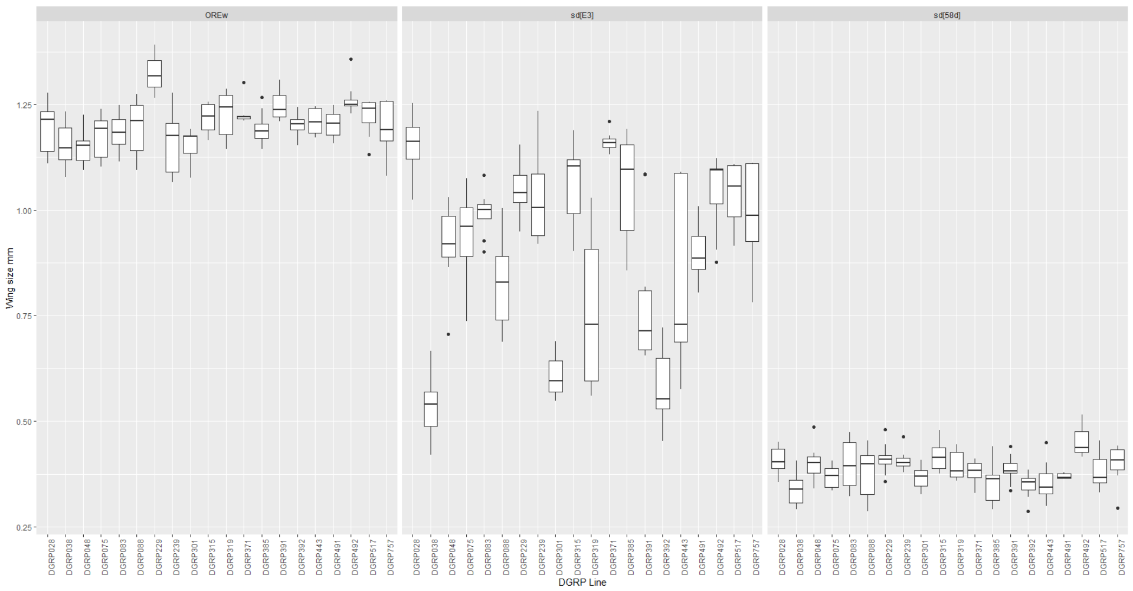
Between line variation and Within line variation
Notes:
This is a boxplot containing raw data on sd allelic series
On the far left boxplot is the wild type ORE environment, center is the sd[E3] environment, and on the right is the sd[58d] environment
This corresponds to phenotypically wild type allelic effects, moderate phenotypic effect, and strong phenotypic effect alleles/enviornments
On the y-axis is a measurement of wing size taken in mm
On the x-axis is the various dgrp lines
I’m going to try and use this slide to explain the difference of between line an within line variation
I would like you to first pay attention to the line means, or the black bars in the center of the boxplots and compare them first two each other in the same genetic environment
Then compare how variable they are between one another in one environment verses the other two environments.
Quickly looking at the graph we can see that between line means show the most variation within the moderate allelic effect environment sdE3
i.e. the means become more spaced out from one another in this moderate effect allele
Now I would like you to pay attention the Q1-Q3 ranges for each of the lines across the genetic environments, for our example we will focus on DGRP line 443
From this we can quickly see that the within line variance is the largest in the moderate allelic effect environment.

Slide 13
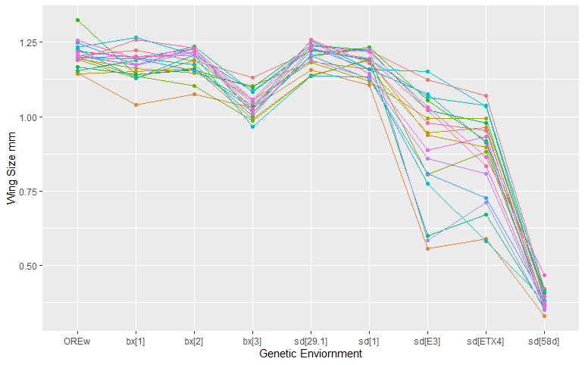
Reaction of the norm of the mean on raw data
Notes:
If we were to create reaction norm of the mean on the raw data it would look like this:
Where we can see that it appears that again moderate phenotypic effect alleles/environments increase the variance of the mean the most

Slide 14
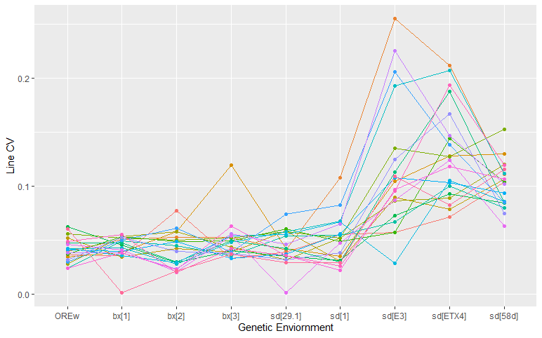
Modified reaction norm graph
Notes:
If we were to utilize a modified reaction norm of the mean we would see the same trend though it doesn’t look as clear cut as during the past reaction norm of the mean.

Slide 15
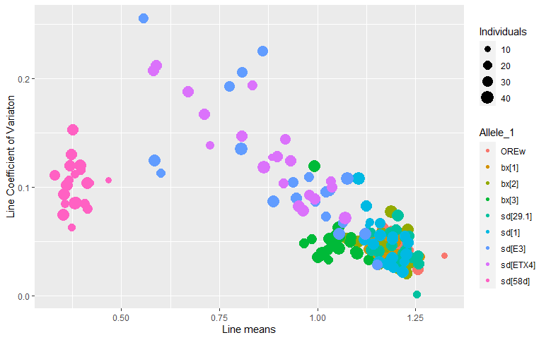
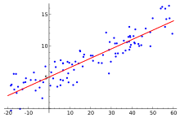
TO USE THE LOG-LINK, OR NOT TO USE THE LOG-LINK?
Trait Mean
Standard Deviation

Slide 16
PREPARING THE DATA FOR MODELLING

Slide 17
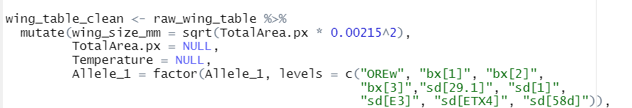
Setting the intercept

Slide 18
Calculating The Levene statistic

Slide 19
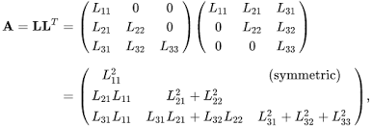
Glm: singularity issue
Notes:
It is very common for overfitted mixed models to result in singular fits. Technically, singularity means that some of the θθ (variance-covariance Cholesky decomposition) parameters corresponding to diagonal elements of the Cholesky factor are exactly zero, which is the edge of the feasible space, or equivalently that the variance-covariance matrix has some zero eigenvalues (i.e. is positive semidefinite rather than positive definite), or (almost equivalently) that some of the variances are estimated as zero or some of the correlations are estimated as +/-1. This commonly occurs in one of two scenarios:
Small numbers of random-effect levels (e.g. <5), as illustrated in these simulations and discussed (in a somewhat different, Bayesian context) by Gelman (2006). This is the case for our dataset with regards to replicates.
Complex random-effects models, e.g. models of the form (f|g) where f is a categorical variable with a relatively large number of levels. This isn’t necessarily applicable to our dataset, considering there are 9 levels for the mutant term.
When singularity occurs, variance values are estimated as zero potentially, or correlation values that are derived from variance values may be estimated as -1 or + 1.
One of the recommendations regarding singularity is the following: “fit the model with the random factor as a fixed effect, get the level coefficients in the sum to zero form, and then compute the standard deviation of the coefficients.” We decided to following this recommendation.

Slide 20
MODELS THAT SUFFER FROM SINGULAR FIT

Slide 21
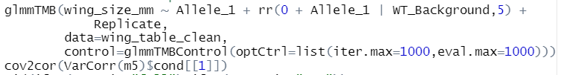
Eureka!: rank-reduced model

Slide 22
Shortcomings of the glmm

